Slide 1

Prescriptions & overdose
Christian Alsider

Slide 2

Introduction
In the past addictions and overdoses were seen as “social class” problems.
The opiate crisis changed that. The dope dealer moved from the trap house to the doctor's office. Suddenly overdoses were no longer the panda eye junkie from a after school PSA, they have high functioning members of society who no one suspects has an addiction.
Was it the change in the prescribing habits of our providers?

Slide 3

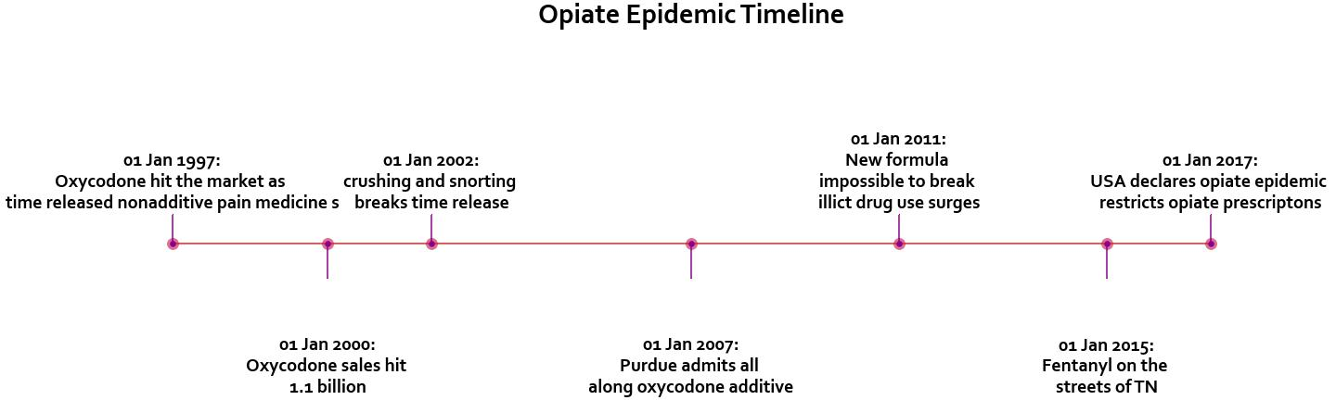
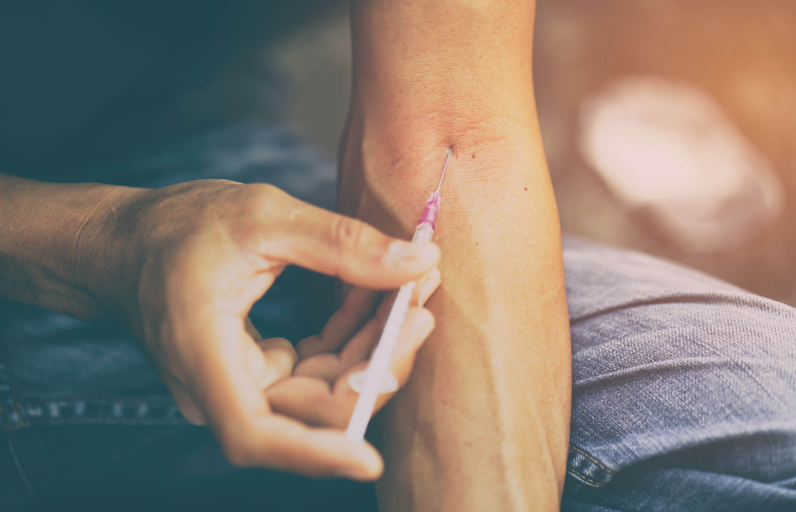
How did we get here?

Slide 4
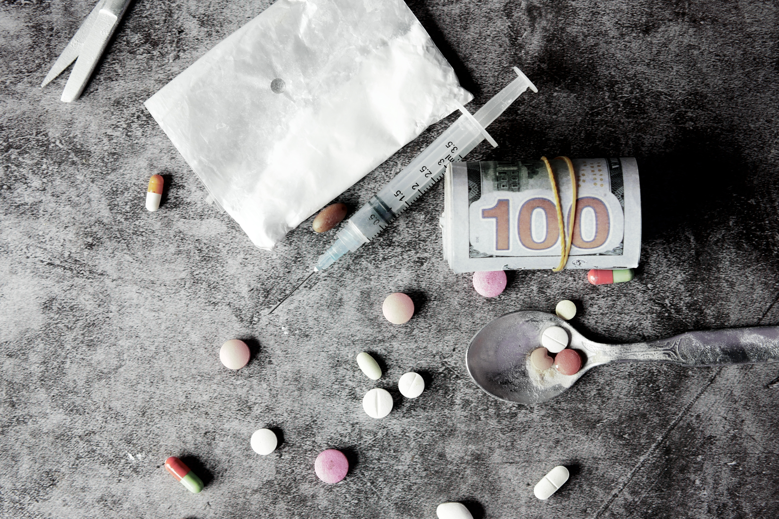
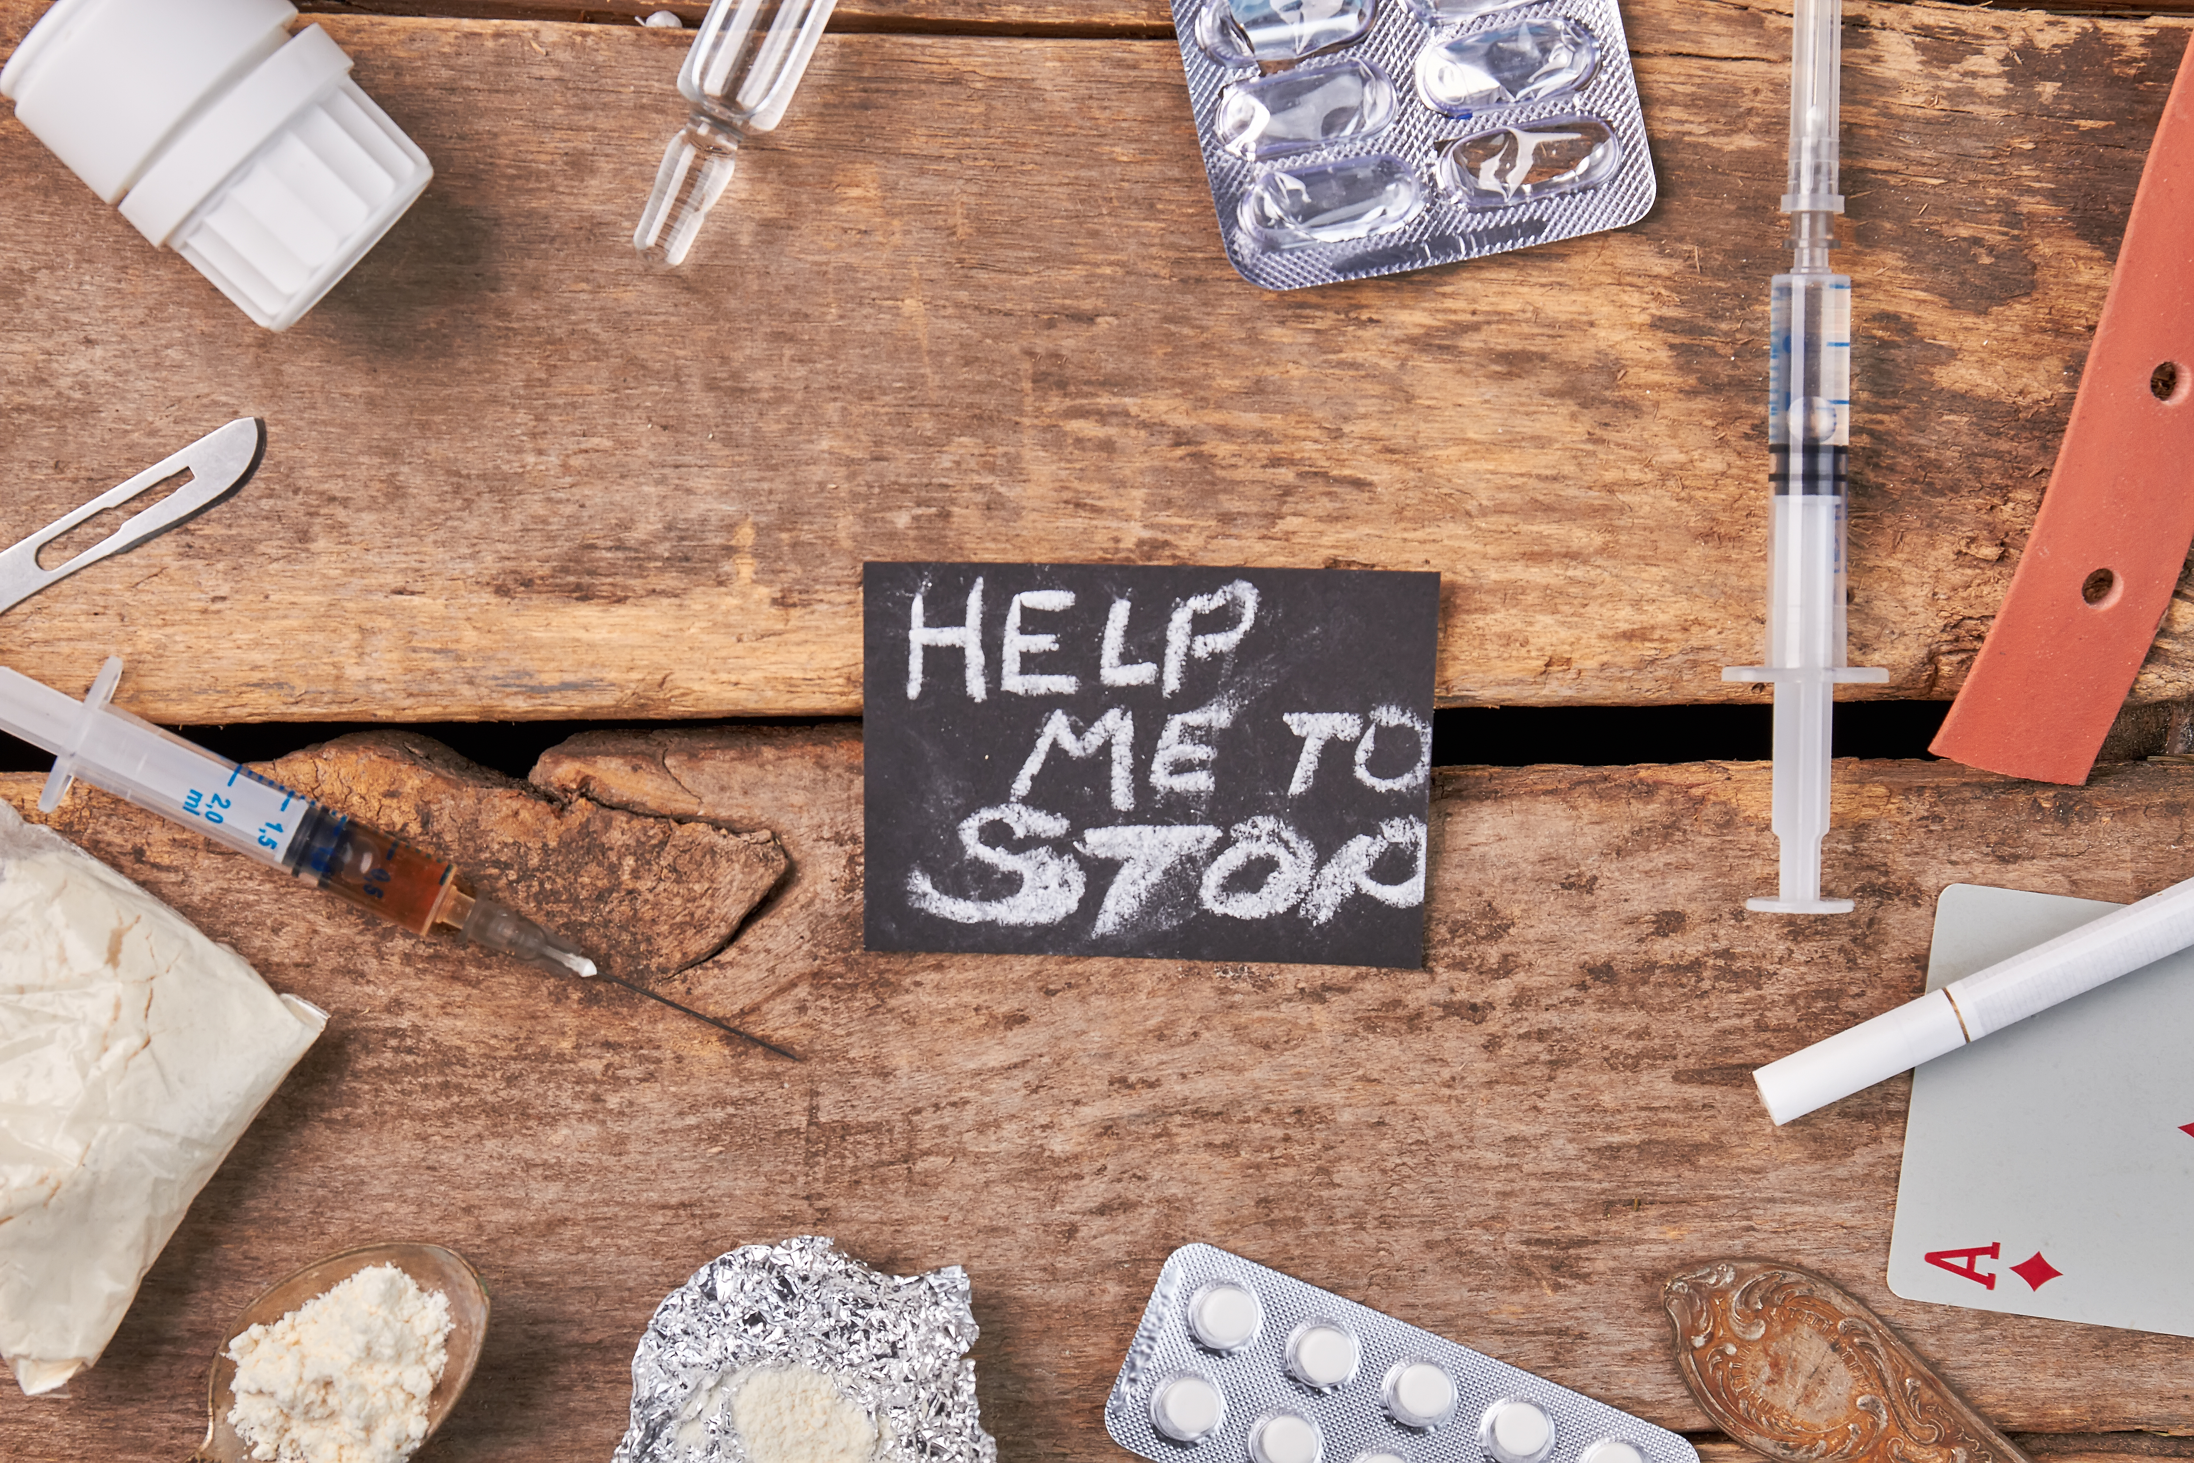
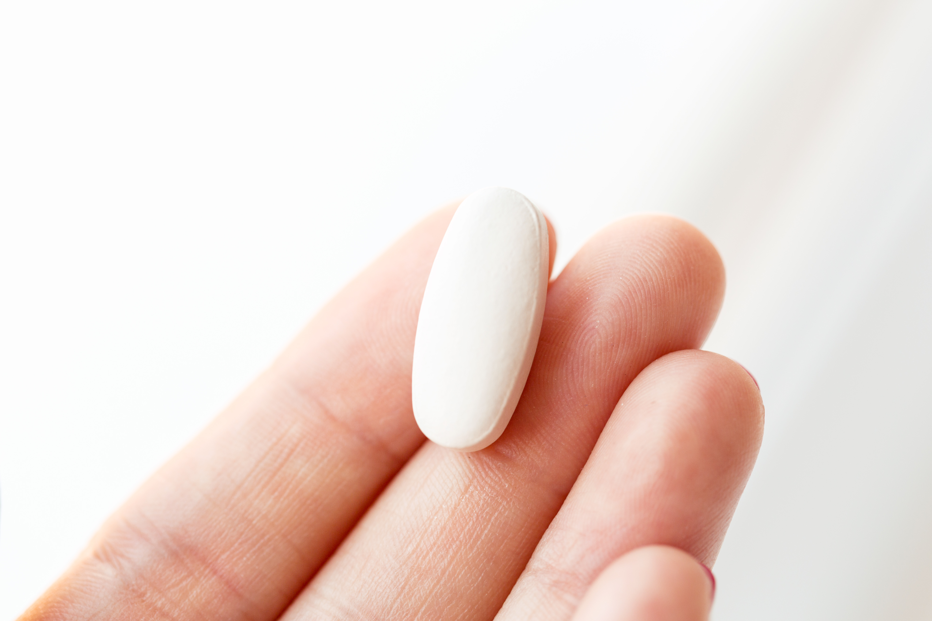
Prescribing trends

Slide 5
Opiate prescription's 2006-2020

Slide 6
Table
 | Category 1 | Category 2 | Category 3 | Category 4
Item 1 | 4.5 | 2.3 | 1.7 | 5.0
Item 2 | 3.2 | 5.1 | 4.4 | 3.0
Item 3 | 2.1 | 1.7 | 2.5 | 2.8
Item 4 | 4.5 | 2.2 | 1.7 | 7.0

Slide 7
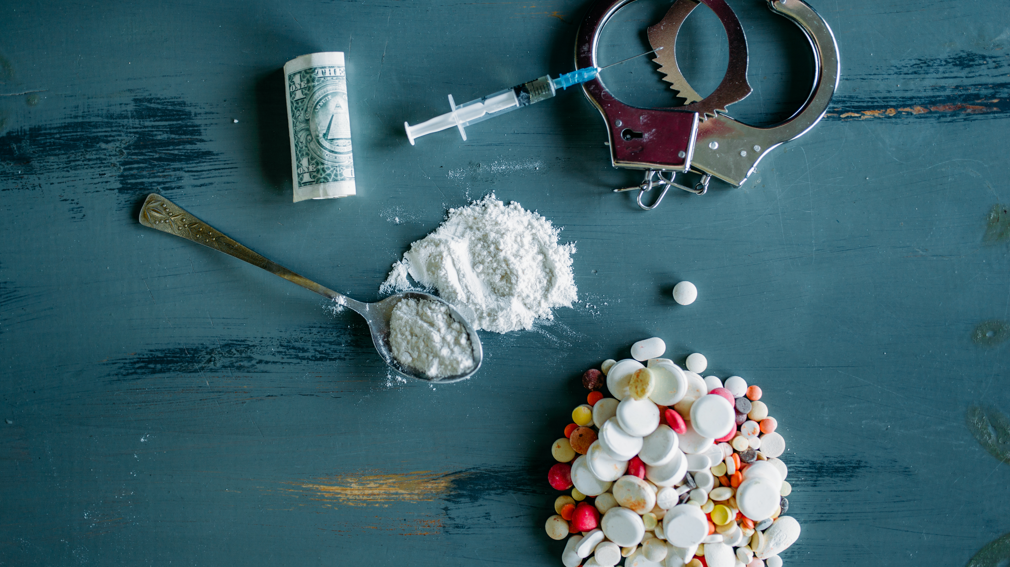
The way to get started is to quit talking and begin doing.
Walt Disney
Fatal overdoses

Slide 8
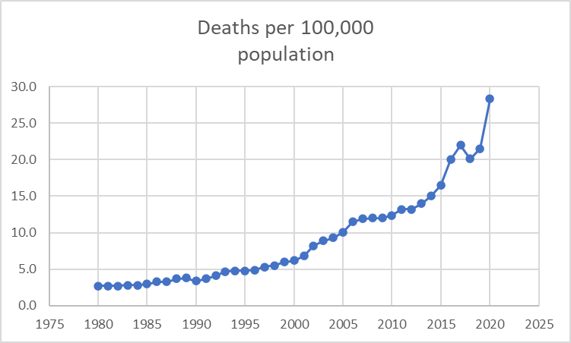
Fatal overdoses USA 1980-2020

Slide 9
Fatal overdoses 2013-2020

Slide 10

The way to get started is to quit talking and begin doing.
Walt Disney
Non Fatal Overdoses
Fatal overdoses

Slide 11
Non Fatal overdoses 2013-2020

Slide 12
Additional content
Subtitle
Subtitle
Subtitle
Add text, images, art, and videos.
Add transitions, animations, and motion.
Save to OneDrive, to get to your presentations from your computer, tablet, or phone.
Open the Design Ideas pane for instant slide makeovers.
When we have design ideas, we’ll show them to you right there.
This PowerPoint theme uses its own unique set of colors, fonts, and effects to create the overall look and feel of these slides.
PowerPoint has tons of themes to give your presentation just the right personality.

Slide 13




Summary
With PowerPoint, you can create presentations and share your work with others, wherever they are. Type the text you want here to get started. You can also add images, art, and videos on this template. Save to OneDrive and access your presentations from your computer, tablet, or phone.

Slide 14


Thank you
Presenter name
Email address
Website

